Slide 1

ASSIGNMENT 7
MIMO Channel Capacity
& BER Analysis

Slide 2
Problem Statement
Modern wireless systems demand higher data rates and reliability without increasing bandwidth.
Key Challenges:
•
Fading channels degrade signal quality.
•
Single antenna systems (SISO) have limited capacity limits.
•
Bit Error Rate (BER) increases in deep fading conditions.
This study investigates how Multiple-Input Multiple-Output (MIMO) technology enhances capacity and how diversity improves BER.

Slide 3
Objectives
1. Capacity Analysis
•
Simulate and compare Channel Capacity for:
2. Error Performance
•
SISO (1x1)
•
Simulate Bit Error Rate (BER) for BPSK modulation.
•
SIMO (1x2)
•
Analyze performance over a Rayleigh Fading channel.
•
MISO (2x1)
•
Verify simulation results against theoretical bounds.
•
MIMO (2x2)

Slide 4


System Architecture Overview
SISO (1x1)
SIMO (1x2)
...
...
Baseline reference
Receive Diversity
MISO (2x1)
MIMO (2x2)
...
...
Transmit Diversity
Spatial Multiplexing

Slide 5
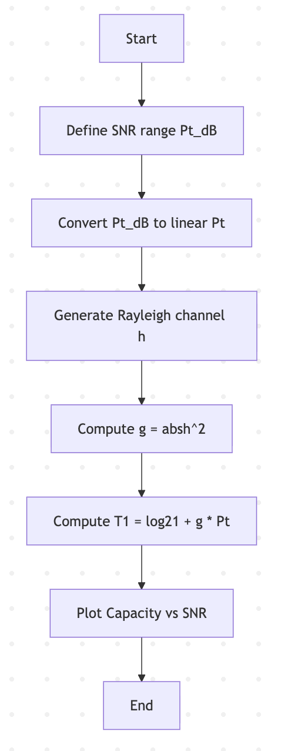
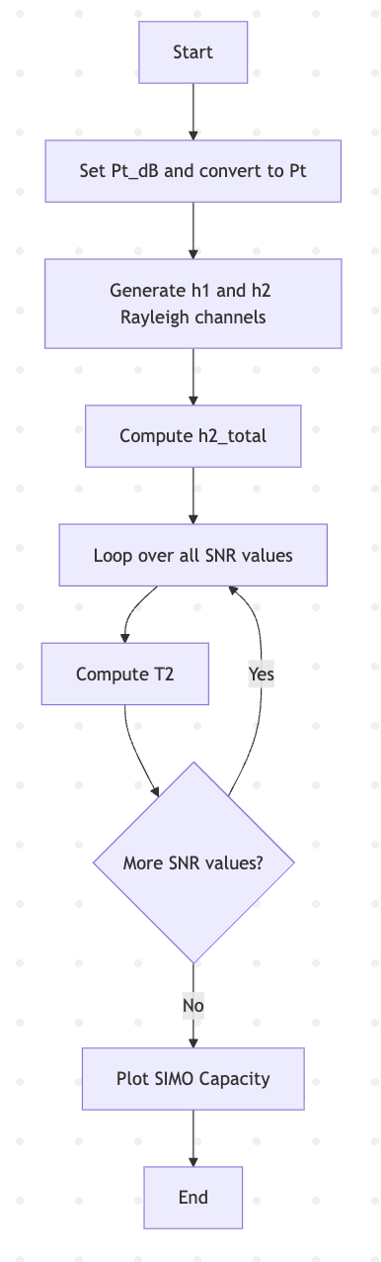
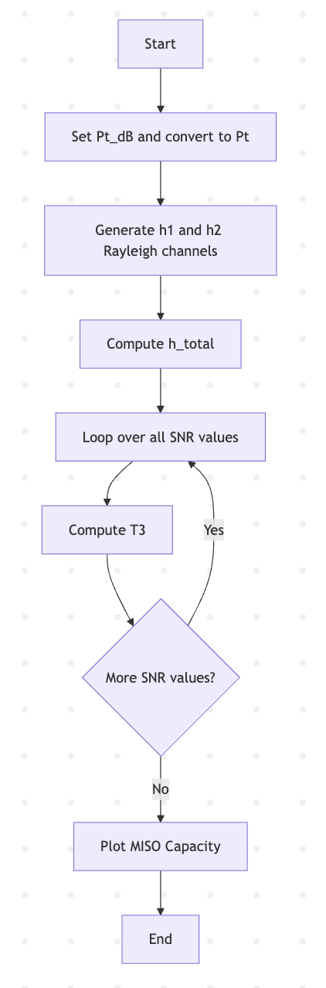
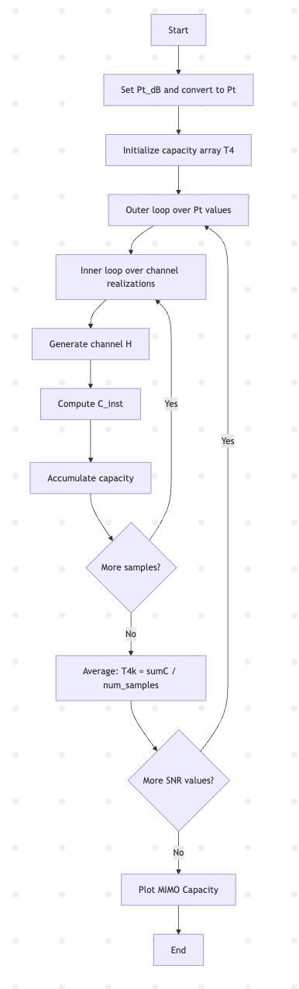





SISO SIMO 2*1 MISO 1*2 MIMO 2*2
(0 - 40 dB)
(Rayleigh H Matrix)

Slide 6
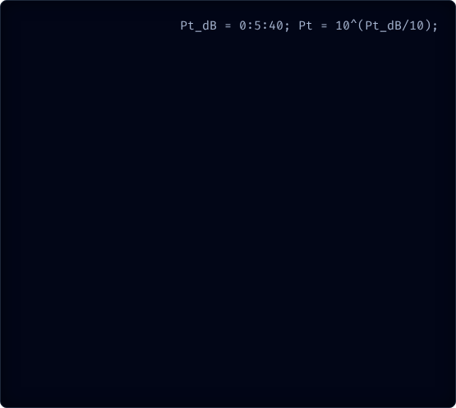
Pseudocode: MIMO Capacity
START
-------------------------------------------------
1. SISO CAPACITY (1×1)
-------------------------------------------------
Define SNR range Pt_dB = 0 to 40 step 5
Convert Pt_dB → Pt (linear scale)
Generate Rayleigh channel h
Compute power gain g = abs(h)^2
For each SNR value:
Compute T1 = log2(1 + g * Pt)
-------------------------------------------------
2. SIMO CAPACITY (1×2)
-------------------------------------------------
Generate Rayleigh channels h1 and h2
Compute total gain h2_total = abs(h1)^2 + abs(h2)^2
For each SNR value:
Compute instantaneous capacity C = log2(1 + Pt * h2_total)
Average over all samples → T2
% SISO Capacity
% MIMO Capacity Formula
% C = log2( det( I + (SNR/Nt) * H * H' ) )
% Average over samples
END
% 1. Define SNR Range
Pt_dB = 0:5:40;
Pt = 10^(Pt_dB/10);
% 2. Iterate for Monte Carlo
FOR k = 1:length(Pt)
% Generate Rayleigh Channel Matrix
H = (randn(Nr, Nt) + 1j*randn(Nr, Nt))/sqrt(2);
% SISO Capacity
T1 = log2(1 + g * Pt(k));
% MIMO Capacity Formula
% C = log2( det( I + (SNR/Nt) * H * H' ) )
inner = eye(Nr) + (Pt(k)/Nt) * (H * H');
C_inst = log2( det(inner) );
% Average over samples
Capacity(k) = mean(C_inst);
END
Logic Explanation
•
Channel H: Complex Gaussian random variables representing Rayleigh fading.
•
Determinant: The core of MIMO capacity. The eigenvalues of HH^H determine the parallel spatial pipes available.
•
Averaging: Monte Carlo simulation (10,000+ runs) is used to find the ergodic capacity.

Slide 7
-------------------------------------------------
3. MISO CAPACITY (2×1) – MRT
-------------------------------------------------
Set Nt = 2
Generate Rayleigh channels h1 and h2
Compute MRT gain h_total = abs(h1)^2 + abs(h2)^2
For each SNR value:
Compute T3 = mean( log2(1 + (Pt/Nt) * h_total) )
-------------------------------------------------
4. MIMO CAPACITY (2×2)
-------------------------------------------------
Set Nt = 2, Nr = 2
Define number of iterations
For each SNR value Pt(k):
Initialize sumC = 0
Repeat for many channel realizations:
Generate 2×2 Rayleigh channel matrix H
Compute C_inst = log2( det( I + (Pt/Nt) * H * H' ) )
Add to sumC
Compute T4(k) = sumC / number_of_samples

Slide 8
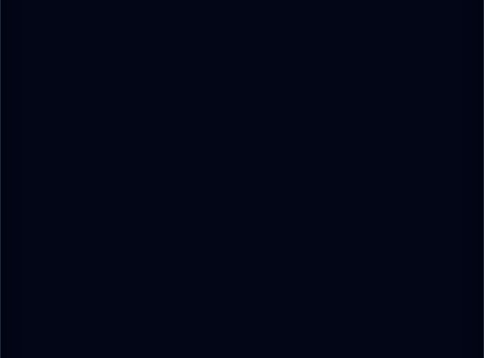
Pseudocode: BER Analysis
% 1. Generate Symbols
s = 2*randi([0 1], 1, N) - 1;
% 2. Channel & Noise
h = (randn + 1j*randn)/sqrt(2);
n = sqrt(N0/2)*(randn + 1j*randn);
y = h * s + n;
% 3. Detection (MRC)
y_mrc = real( conj(h) * y );
detected_bits = (y_mrc >= 0);
% 4. Error Counting
BER = sum(detected_bits != sent_bits) / N;
% 3. Detection (MRC)
% 4. Error Counting
Logic Explanation
•
BPSK Symbols: Generated as -1 and +1.
•
Noise: Added as AWGN (Complex Gaussian).
•
MRC Detection: Maximum Ratio Combining. We multiply the received signal y by the conjugate of the channel h^ to align phases and maximize SNR.

Slide 9
Results & Conclusion
Capacity Results
•
MIMO (2x2): Highest capacity. Slope increases linearly with min(Nt, Nr).
•
SIMO (1x2): Better than SISO due to logarithmic array gain.
•
SISO (1x1): Lowest capacity baseline.
BER Results
•
Simulation perfectly matches theoretical Rayleigh curve.
•
BER decreases linearly (on log scale) as SNR increases.

Slide 10
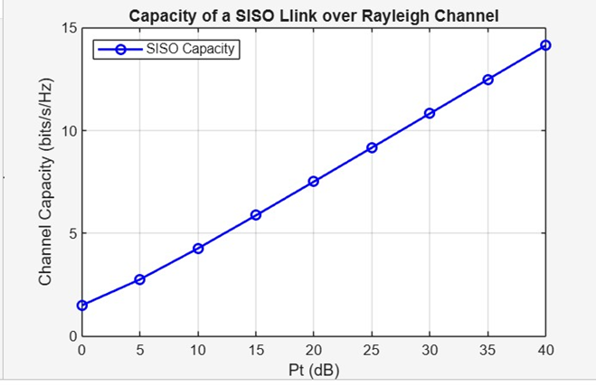
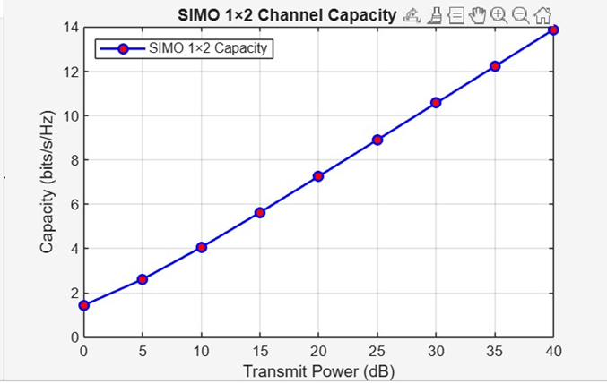
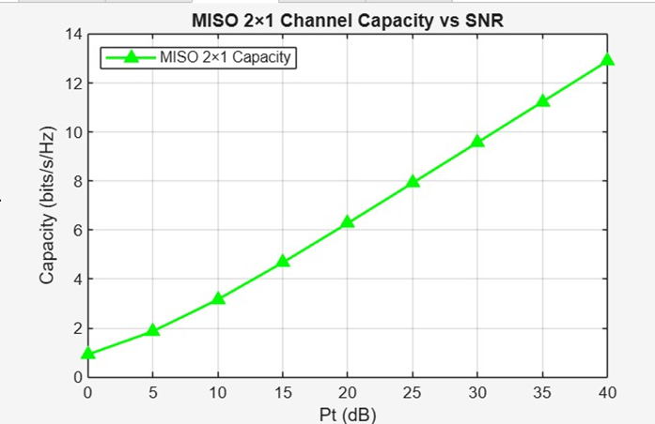
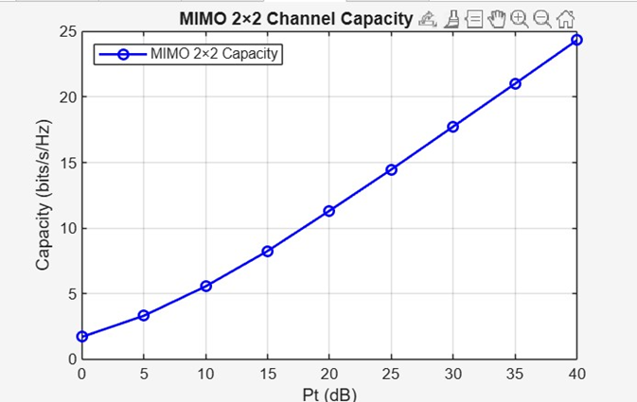

Slide 11
